Slide 1


PROJECT 2: CREATING A DATABASE IN MYSQL
MARIO
VITHUshan
ABDUL

Slide 2
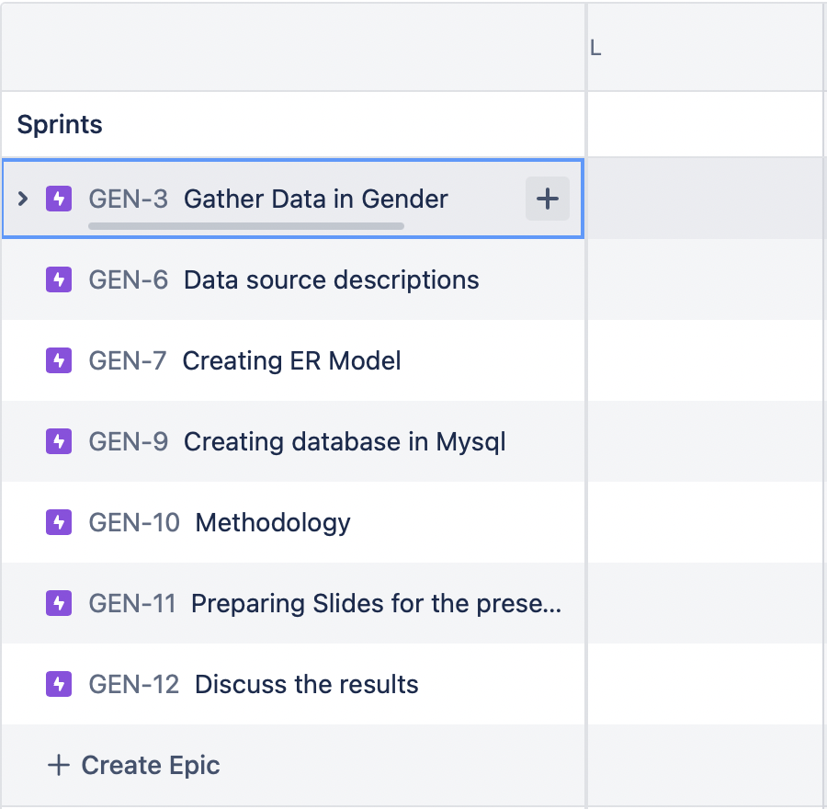
JIRA PLANNING

Slide 3
PYTHON API CODE
import wbgapi as wb
wb.search('gender')
emp_f=wb.data.DataFrame('SL.EMP.TOTL.SP.FE.NE.ZS', ['BRA', 'VEN', 'CHL', 'ECU', 'ARG'])
emp_m=wb.data.DataFrame('SL.EMP.TOTL.SP.MA.NE.ZS', ['BRA', 'VEN', 'CHL', 'ECU', 'ARG’])
mort_f=wb.data.DataFrame('SP.DYN.AMRT.FE', ['BRA', 'VEN', 'CHL', 'ECU', 'ARG'])
mort_m=wb.data.DataFrame('SP.DYN.AMRT.MA', ['BRA', 'VEN', 'CHL', 'ECU', 'ARG'])
pop_f=wb.data.DataFrame('SP.POP.TOTL.FE.IN', ['BRA', 'VEN', 'CHL', 'ECU', 'ARG'])
pop_m=wb.data.DataFrame('SP.POP.TOTL.MA.IN', ['BRA', 'VEN', 'CHL', 'ECU', 'ARG'])
#export data to csv files
emp_f.to_csv('emp_f.csv', sep='\t', encoding='utf-8')
emp_m.to_csv('emp_m.csv', sep='\t', encoding='utf-8')
mort_f.to_csv('mort_f.csv', sep='\t', encoding='utf-8')
mort_m.to_csv('mort_m.csv', sep='\t', encoding='utf-8')
pop_f.to_csv('pop_f.csv', sep='\t', encoding='utf-8')
pop_m.to_csv('pop_m.csv', sep='\t', encoding='utf-8')

Slide 4
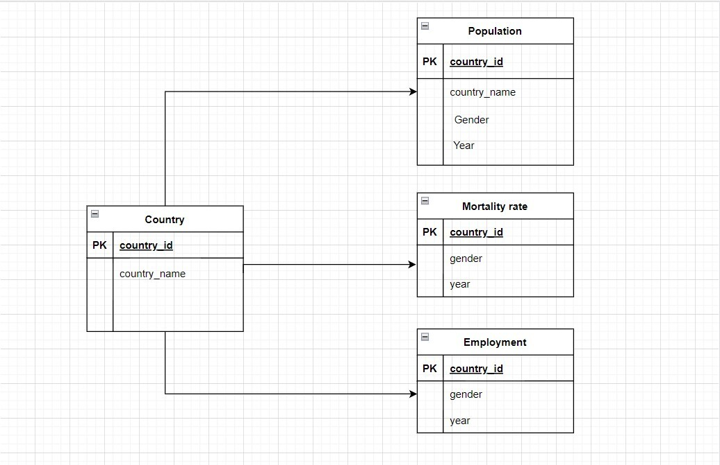
ERD MODEL

Slide 5
DATA SOURCE AND METADATA
Description:-
To measure and compare gender evolvement throughout the years (2000-2020) in terms of genders population, mortality rate per 1000 and employment percentage between both genders. Limit the comparison to one continent (South America) choose 5 countries (Brazil – Argentina – Chile – Ecuador – Venezuela)
Methodology:-
Create indexes related to :
(Countries: Brazil – Argentina – Chile – Ecuador – Venezuela)
Employment %
Population
Mortality / 1000
*Using EXCEL CSV, MYSQL, PYTHON
Metadata:-
WorldBank.org
Delivery:-
Interpret information related to employment %, population and mortality per gender

Slide 6
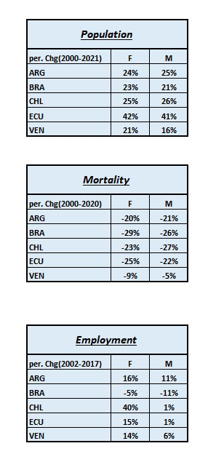
Interpretation

Slide 7
SQL SCRIPT
Create database gender;
use gender;
select *from emp_f;
alter table emp_f rename column economy to eco_emp_f;
alter table emp_m rename column economy to eco_emp_m;
alter table mort_f rename column economy to eco_mort_f;
alter table mort_m rename column economy to eco_mort_m;
alter table pop_f rename column economy to eco_pop_f;
alter table pop_m rename column economy to eco_pop_m;
create table emp_all as
select emp_f.*, emp_m.* from emp_f
inner join emp_m
on emp_f.eco_emp_f=emp_m.eco_emp_m;

Slide 8
SQL SCRIPT p2
select * from emp_all;
create table pop_all as
select pop_f.*, pop_m.* from pop_f
inner join pop_m
on pop_f.eco_pop_f=pop_m.eco_pop_m;
select * from pop_all;
create table mort_all as
select mort_f.*, mort_m.* from mort_f
inner join mort_m
on mort_f.eco_mort_f=mort_m.eco_mort_m;

Slide 9
SQL SCRIPT p3
alter table emp_all
drop column eco_emp_m;
alter table emp_all rename column eco_emp_f to eco_emp;
alter table pop_all
drop column eco_pop_m;
alter table pop_all rename column eco_pop_f to eco_pop;
alter table mort_all
drop column eco_mort_m;
alter table mort_all rename column eco_mort_f to eco_mort;
select * from mort_all;
select * from emp_all;
select * from pop_all;

Slide 10
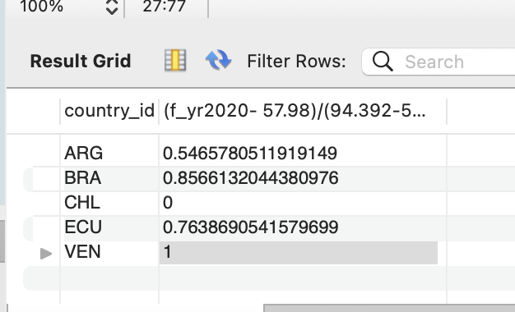
Normalization Example
SELECT * FROM gender.mort_all;
select min(f_yr2020), max(f_yr2020) from pop_all;
create table normalization_mortf as
select mort_all.country_id, (f_yr2020- 57.98)/(94.392-57.98) from mort_all;

